Slide 1

TEAM MEMBERS: PRITHIKASREE S B(113321243039) RATHNA MAALA S V(113321243040) SAKTHIPRIYA P(113321243044) SALMA M (113321243045)
DEPARTMENT OF ARTIFICIAL INTELLIGENCE AND DATA SCIENCE
PROJECT NAME :Public Transport Optimization
TEAM NAME : Proj_224782_Team_7

Slide 2
PROJECT DEFINITION:
The project involves integrating IoT sensors into public transportation vehicles to monitor ridership, track locations, and predict arrival times.
The goal is to provide real-time transit information to the public through a public platform, enhancing the efficiency and quality of public transportation services.
This project includes defining objectives, designing the IoT sensor system, developing the real-time transit information platform, and integrating them using IoT technology and Python.

Slide 3

OBJECTIVES:
The objectives of the public transport is optimization should make the possibilities of efficiency, cost effectiveness, safety, and other important measures are as follows
Enhance Efficiency and Reliability: To ensure that the passengers should not waste there time by making the passengers to get information of the transport details.
Enhance Safety and Security: To implement safety measures for the passengers and staffs.
Financial Sustainability: To optimize the cost-effectiveness in the public transport services.
Data-Driven Decision-Making: To collect and analyse data on passengers flows, route performance, and other measures to inform decision-making

Slide 4
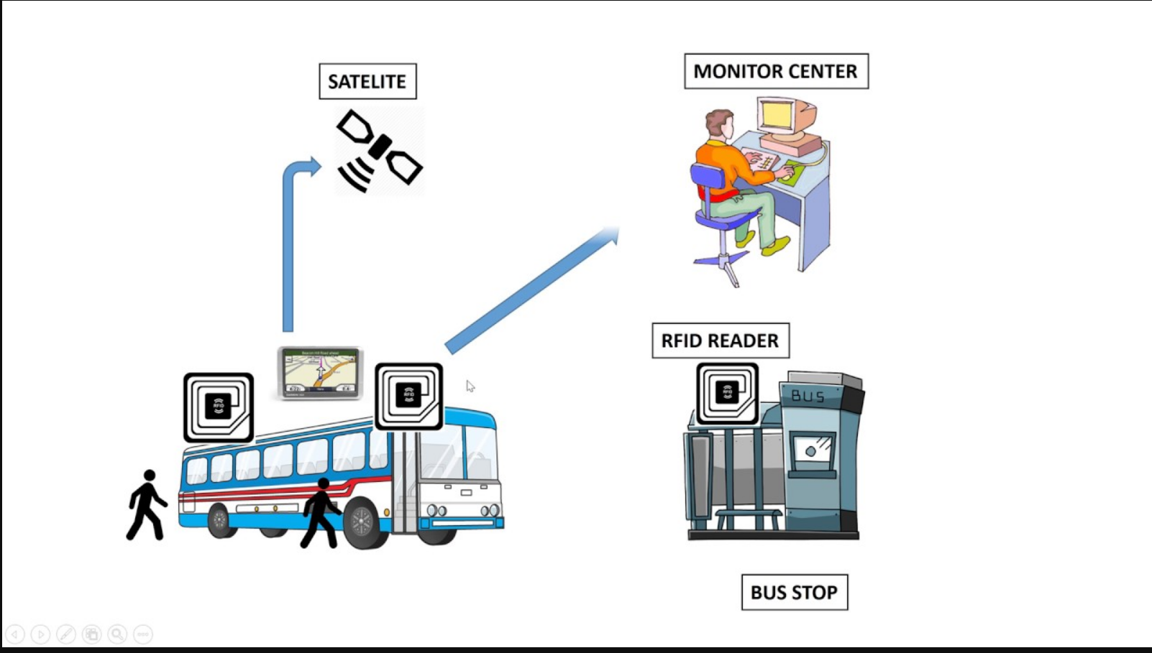
IoT SENSOR DESING:

Slide 5
IOT SENSOR DESIGN:
We are going to identify the key places where the sensors is going to be deployed, considering the buses, bus stops, traffic signals, and all the other required places.
We are choosing the appropriate sensors such as global positioning system(GPS), temperature sensor, accelerometer sensors, odometer sensors which are used for monitoring the public transports.
We ensure strong network connectivity (eg : 5G, LoRaWAN) to support data transmission from sensors to a central monitoring system.
We make the data availability by making an real time web services for passengers convenience.
Finally we make the security measures to protect data of the passengers from the unauthorized user access.

Slide 6
REAL-TIME TRANSIT INFORMATION PLATFORM:
Our aim in the public transport optimization is to create an web-based and user friendly mobile apps that provide about the real-time public transport updates to the public.
Live Traffic Updates: The passengers should able to know where the transport has arrived or not and check for timings.
Interactive Maps: It will ensure an easy way of interface for the user to navigate with their cities effortlessly.
Transport History: The passengers can get the history of the specific transport and the timings of the transport.

Slide 7
INTERGRATION APPROACH:
Our concept of public transport optimization is based on the web-based platform ;We are aiming to get a best experience for the user interactive platform.
Web based platform:Our web-based platform serves as the cornerstone of this integration. With an intuitive interface accessible from any web browser, it offers a comprehensive view of the public transport optimization . Here's how it plays a pivotal role:
Centralized Data Hub: The web platform acts as a centralized data hub, collecting real-time public transport data from various sources, including IoT sensors, traffic cameras, and user-generated reports.
Data Processing and Analysis: Advanced algorithms process incoming data to generate real-time transport updates, transport availability, and route recommendations. This analysis is the backbone of our system.
User Accounts: For those who prefer a personalized experience, users can create accounts on the web platform. This facilitates customized route planning and alert settings.

Slide 8
INTEGRATION APPROACH:
Mobile Apps:Our mobile apps, available for both iOS and Android, extend the platform's capabilities to users on the move.
Real-Time Updates: Receive push notifications on your mobile device, ensuring you're always in the know about transport details and route changes.
GPS Integration: Leverage your device's GPS capabilities for accurate location-based services. Get directions, estimated arrival times, and alerts tailored to your current location.
Reporting on the Go: Empower users to report traffic issues directly from their smartphones, contributing to a dynamic and responsive ecosystem.
Offline Access: In areas with limited connectivity, users can access cached data, ensuring uninterrupted service

Slide 9
INTEGRATION BENEFITS:
By seamlessly integrating the web-based platform and mobile apps, we provide a unified, all-encompassing solution to the public:
Real-Time Consistency: Users experience consistent real-time data and features across both web and mobile platforms.
Cross-Device Compatibility: Switch effortlessly between devices while maintaining access to the same personalized settings and data.
Data Synergy: Information gathered from mobile app users, such as incident reports, feeds back into the web platform for a richer, more dynamic dataset.
Enhanced User Engagement: This integration fosters a stronger sense of community and engagement, as users contribute to and benefit from a shared, up-to-the-minute transport intelligence network.

Slide 10
CONCLUSION:
Optimizing public transport is not just a technical challenge but also requires careful consideration of social, environmental, and economic factors. By using the latest technologies and insights, we can create public transport systems that are fast, affordable, accessible, and sustainable.

Slide 11
THANK YOU

